Slide 1
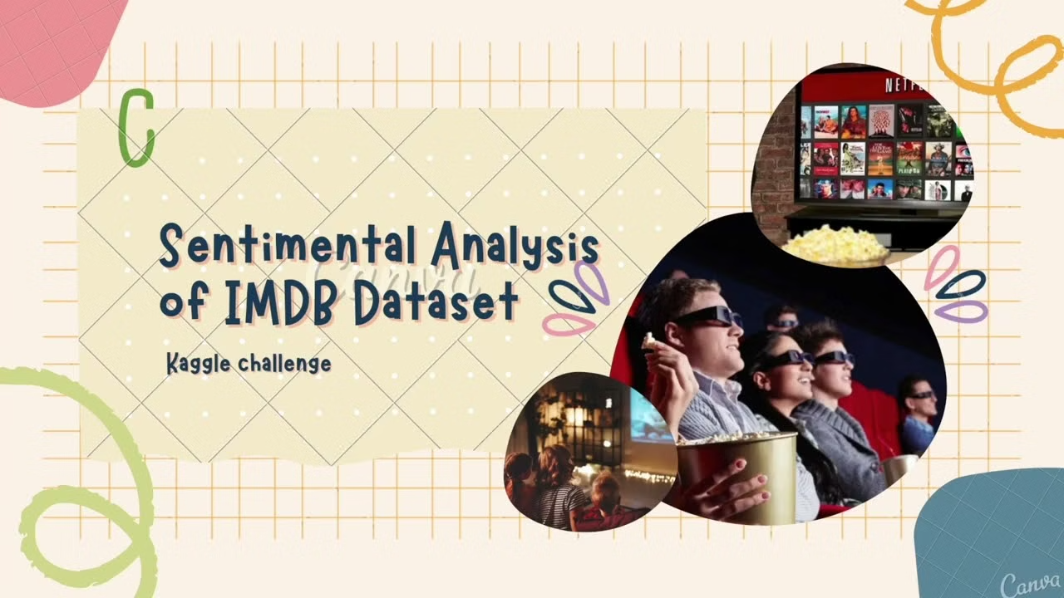
Sentiment Analysis of Movie Reviews
Unlocking Audience Insights from IMDB Data

Slide 2

Our Team
Rana Yasser Anter
Ahmed Rabie
Youssef Mohamed
Youssef Tarek
Youssef Magdy
Hazem Mohamed

Slide 3
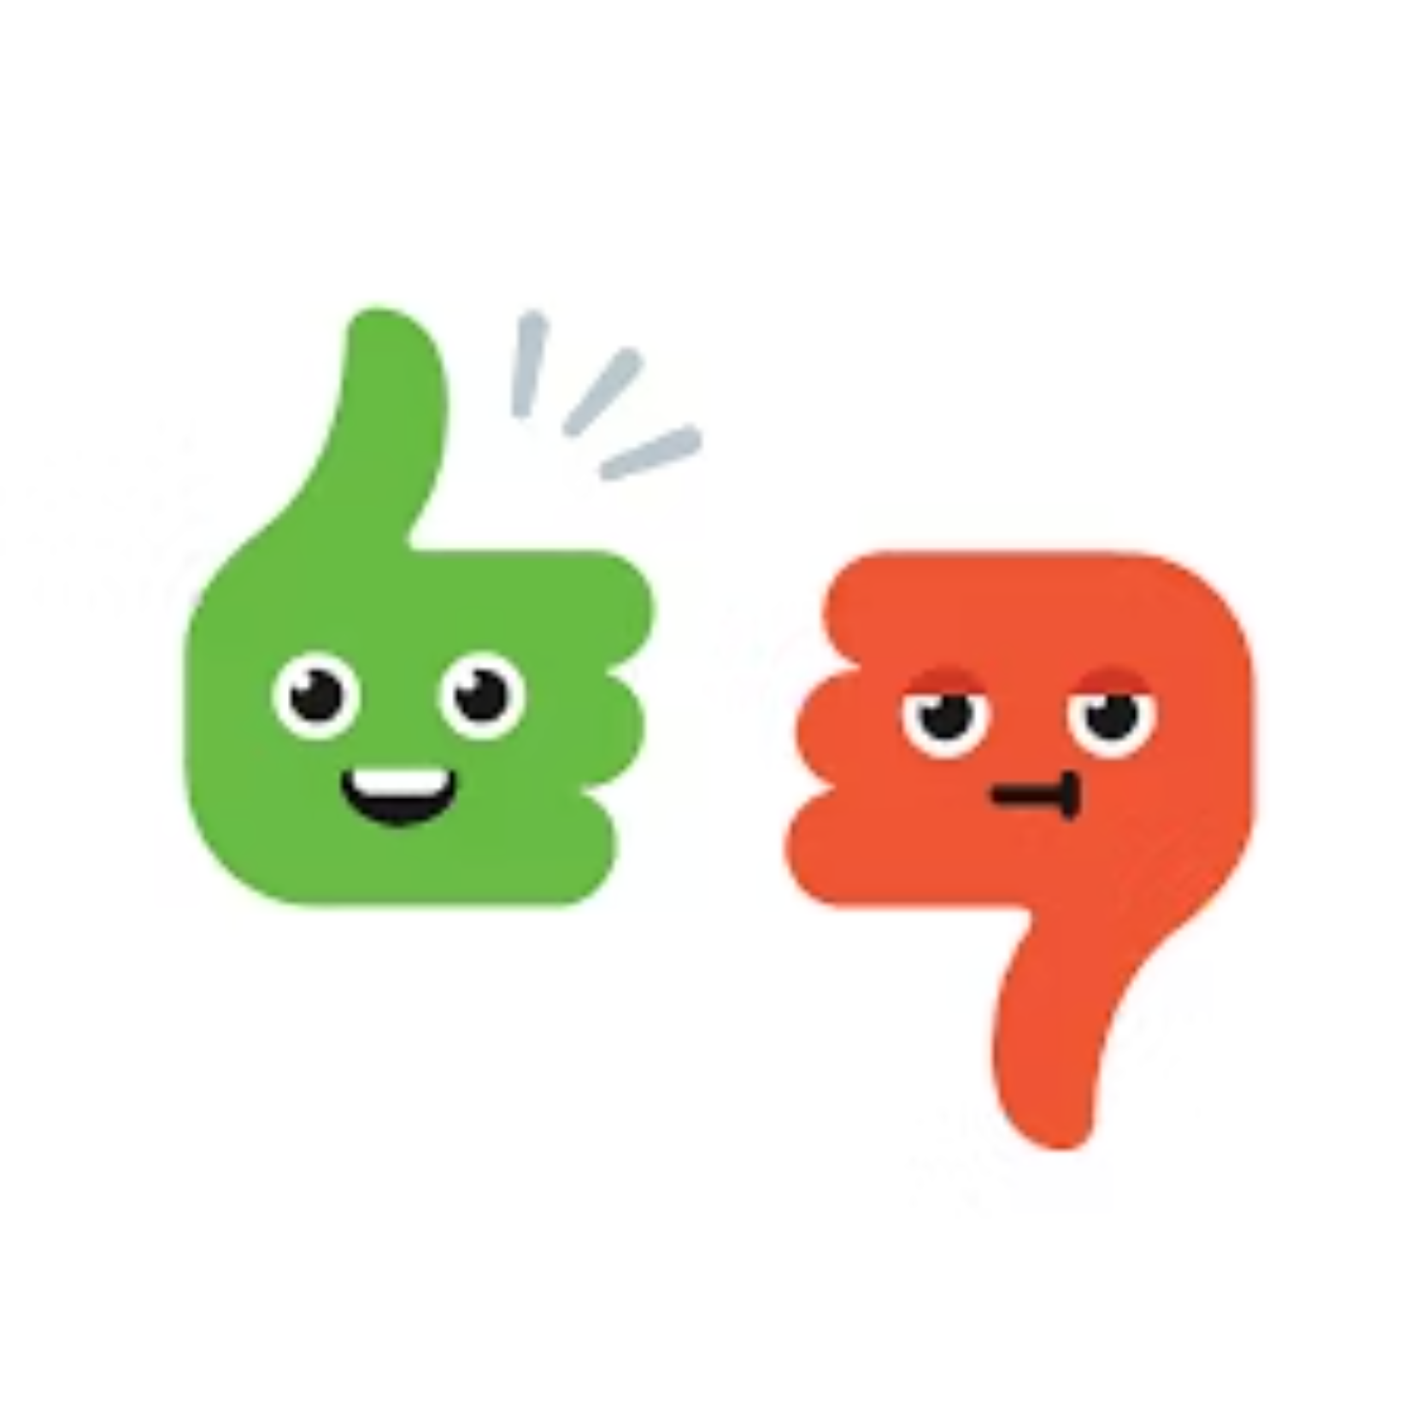
Introduction
This project focuses on Sentiment Analysis of movie reviews from the IMDB dataset, aiming to classify each review as Positive or Negative.
We utilized Natural Language Processing (NLP) and Deep Learning to achieve high accuracy in classification.

Slide 4

Problem & Solution
Problem
Solution
Thousands of daily IMDB reviews.
AI-powered Sentiment Analysis.
Manual reading is time-consuming and biased.
Automated classification of reviews.
Difficulty in gauging overall sentiment.
Fast, accurate, and objective insights.

Slide 5





Project Objectives
Develop Intelligent Model
Classify Reviews
Save Time
Analyze IMDB movie reviews.
Categorize into Positive or Negative.
Automate review analysis.
Ensure Fairness
Support Decision-Makers
Reduce human bias.
Provide accurate audience insights.

Slide 6

Dataset Description
Source: Kaggle – IMDB Movie Reviews Dataset.
Content: Real user movie reviews.
Labels: Positive or Negative.
Size: 50,000 reviews (25,000 training, 25,000 testing).
Format: Text-based (plain English).

Slide 7
Methodology / Approach
01
02
Data Preprocessing
Text Representation
Cleaning (nulls, duplicates), text normalization (lowercasing, stopwords, punctuation).
TF-IDF, Word Embeddings (Word2Vec / GloVe).
03
04
Algorithms Applied
Training & Testing
Logistic Regression, Deep Learning model.
Dataset splitting (e.g., 80% training – 20% testing), model training, performance evaluation.

Slide 8
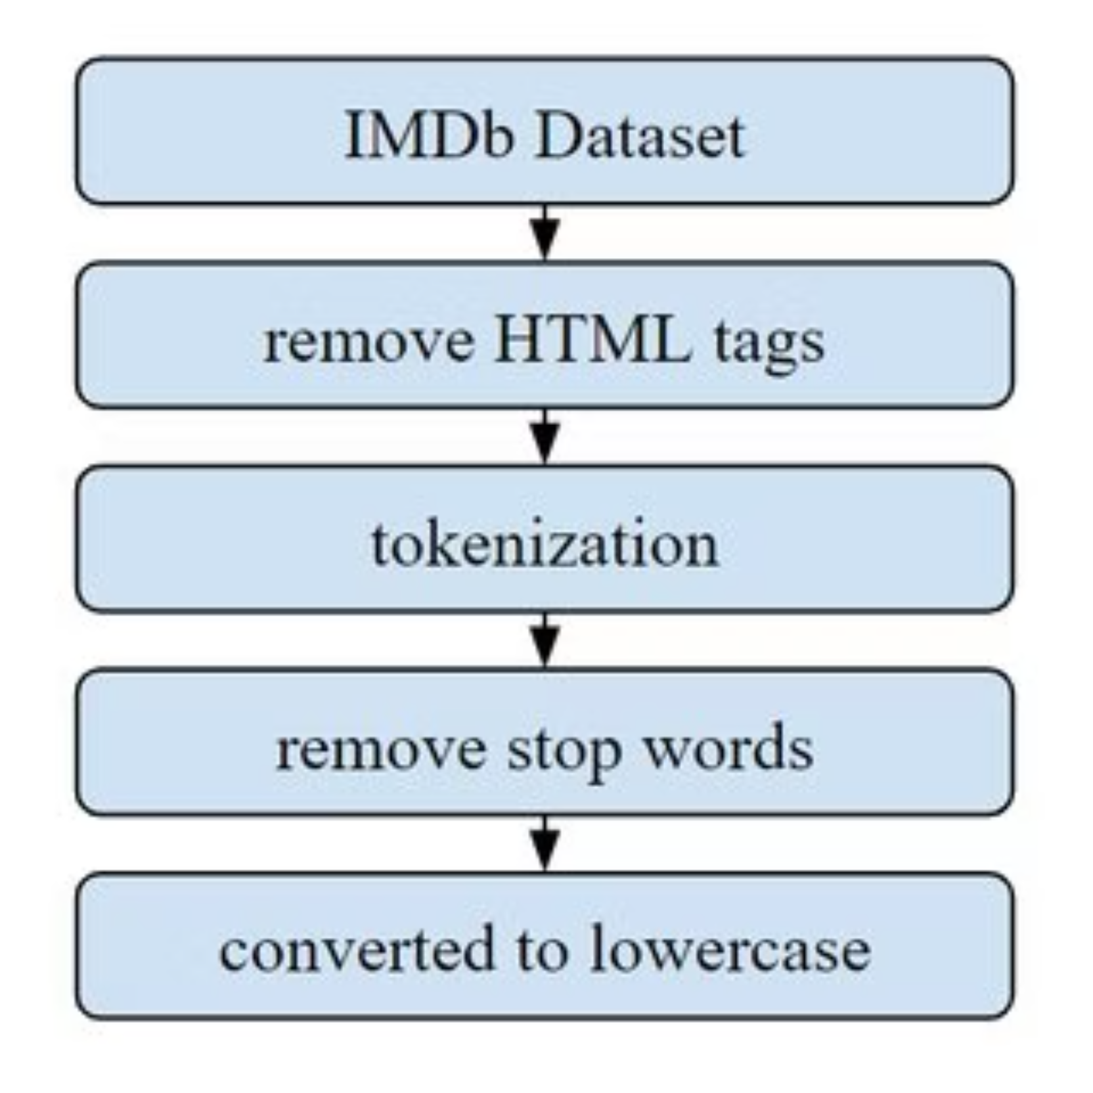
IMDB-Specific Preprocessing
Remove HTML tags.
Replace contractions (e.g., "don't" → "do not").
Handle emoticons.
This specialized cleaning enhances the effectiveness of review analysis.

Slide 9
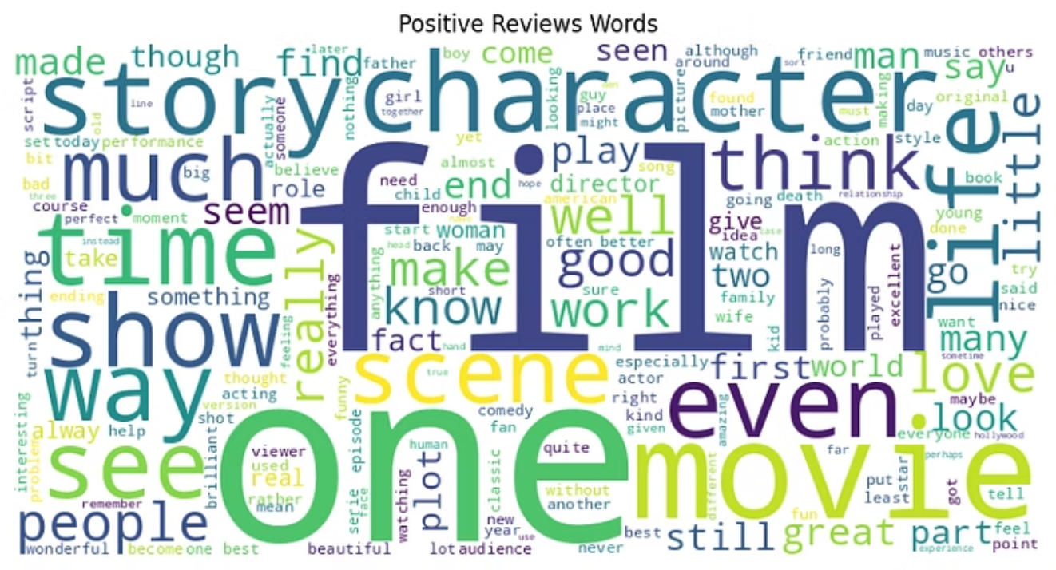
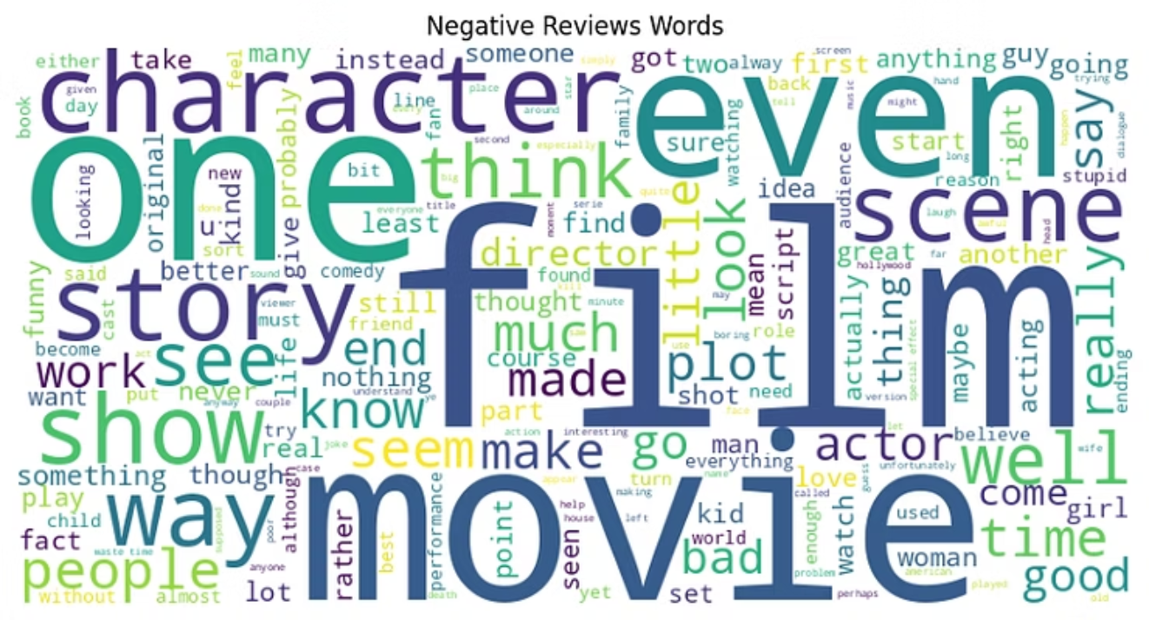
Model Architecture
Visual representation of the deep learning model architecture and data flow.

Slide 10
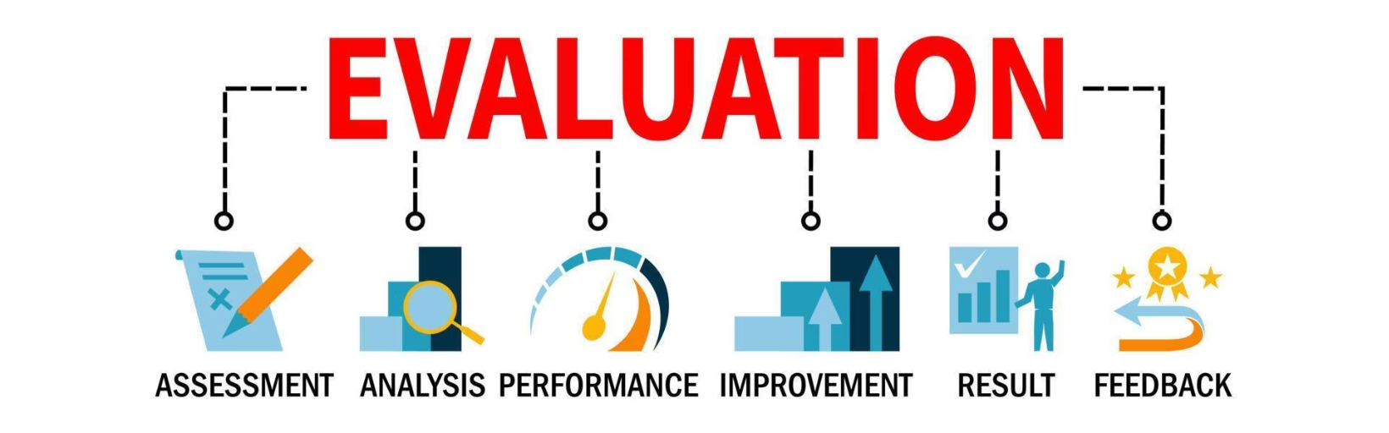
Results & Evaluation
Model Accuracy
Logistic Regression: ~86%
Best Model → Logistic Regression

